Slide 1


ICT3117: IT Project Management
Module 3:
Project Planning for Technology and Software Development Projects
Simon F. Lubambo
Software Engineer
Department of Computing & Technology
Faculty of Engineering, Design & Technology
October 2023

Slide 2

Introduction
Well-structured project planning plays a crucial role in technology and software development for several reasons:
Resource Allocation
Timely Delivery
Risk Mitigation
Scope Management
Communication
Quality Assurance
Budget Control
Notes:
Project planning helps allocate resources efficiently. This includes human resources, hardware, software, and budget. By knowing what's needed and when, you can prevent resource shortages and overages., A well-planned project is more likely to be delivered on time. It helps you set realistic deadlines, identify potential delays, and plan for contingencies., Identifying and addressing potential risks is a vital part of project planning. By anticipating challenges and uncertainties, you can take proactive measures to mitigate risks, reducing the likelihood of costly setbacks., Project planning helps define the project scope clearly. This ensures that the project team and stakeholders have a shared understanding of what needs to be delivered, reducing scope creep., Planning facilitates communication and collaboration among team members and stakeholders. When everyone knows the project plan, roles, and responsibilities, it enhances coordination and decision-making. Planning should include quality control and assurance processes. This ensures that the final product meets or exceeds quality standards and user expectations., Proper planning helps keep the project within budget. By estimating costs and monitoring expenses, you can avoid financial overruns.

Slide 3
Introduction
Agile Adaptation
Stakeholder Satisfaction
Documentation
Efficient Problem Solving
Continuous Improvement
Notes:
In software development, agile methodologies like Scrum and Kanban are prevalent. These methodologies require a well-structured plan for iterative development, where adaptability is key.,
Meeting or exceeding stakeholder expectations is essential. A well-planned project increases the chances of delivering a product that aligns with stakeholders' needs and goals., Planning generates documentation that can be useful throughout the project's lifecycle and beyond. It provides a reference for decision-making and can be a valuable resource for future projects., When issues arise during the project, a well-structured plan can serve as a basis for problem-solving. It helps in quickly assessing the impact of issues and determining appropriate solutions., By regularly reviewing and updating the project plan, you can implement lessons learned from previous projects, fostering a culture of continuous improvement.

Slide 4
Outline
Breaking Down Work Structure
Activity Sequencing and Scheduling
Estimating Activity Durations and Resources
Developing a Project Schedule with Timelines
Risk Identification and Assessment

Slide 5
Breaking Down Work Structure
Breaking Down Work Structure is often referred to as a Work Breakdown Structure (WBS).
A work breakdown structure (WBS) is a visual, hierarchical and deliverable-oriented deconstruction of a project.
It is a helpful diagram for project managers because it allows them to break down their project scope and visualize all the tasks required to complete their projects.

Slide 6
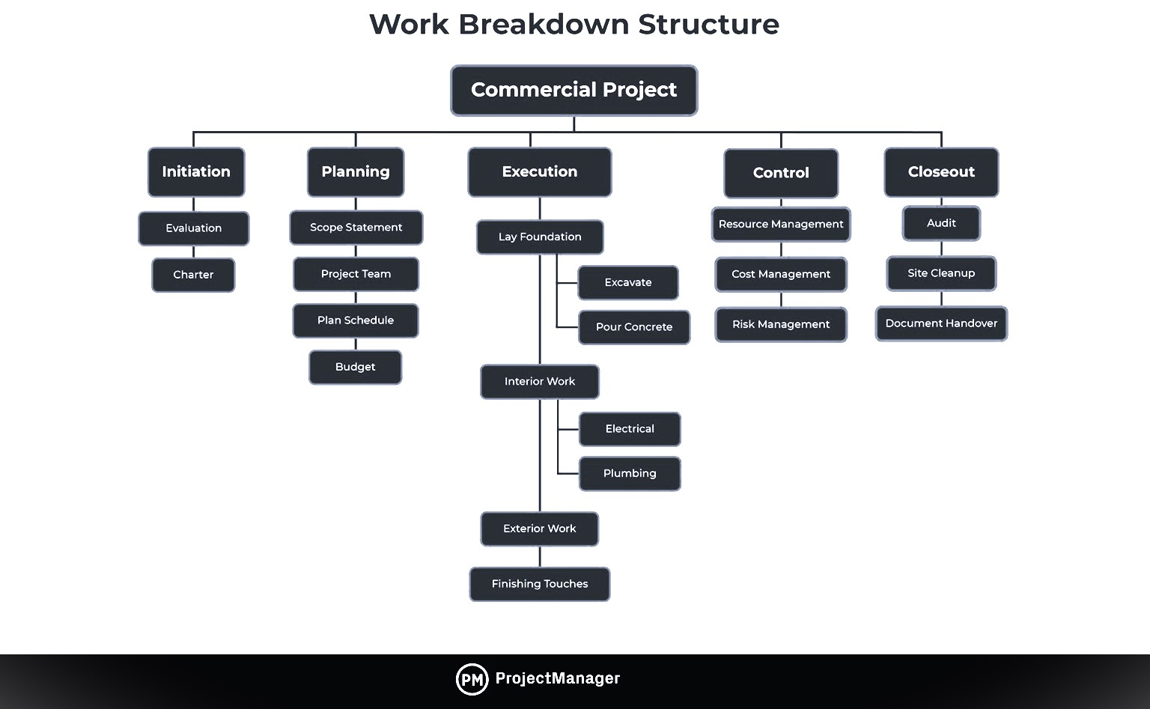
Breaking Down Work Structure

Slide 7
WBS Types
Deliverable-Based Work Breakdown Structure
This first breaks down the project into all the major areas of the project scope as control accounts and then divides those into project deliverables and work packages.
Phase-based
This displays the final deliverable on top, with the WBS levels below showing the five phases of a project (initiation, planning, execution, control and closeout). Just as in the deliverable-based WBS, the project phases are divided into project deliverables and work packages.

Slide 8
WBS Types
Deliverable-Based Work Breakdown Structure
This first breaks down the project into all the major areas of the project scope as control accounts and then divides those into project deliverables and work packages.
Phase-based
This displays the final deliverable on top, with the WBS levels below showing the five phases of a project (initiation, planning, execution, control and closeout). Just as in the deliverable-based WBS, the project phases are divided into project deliverables and work packages.

Slide 9
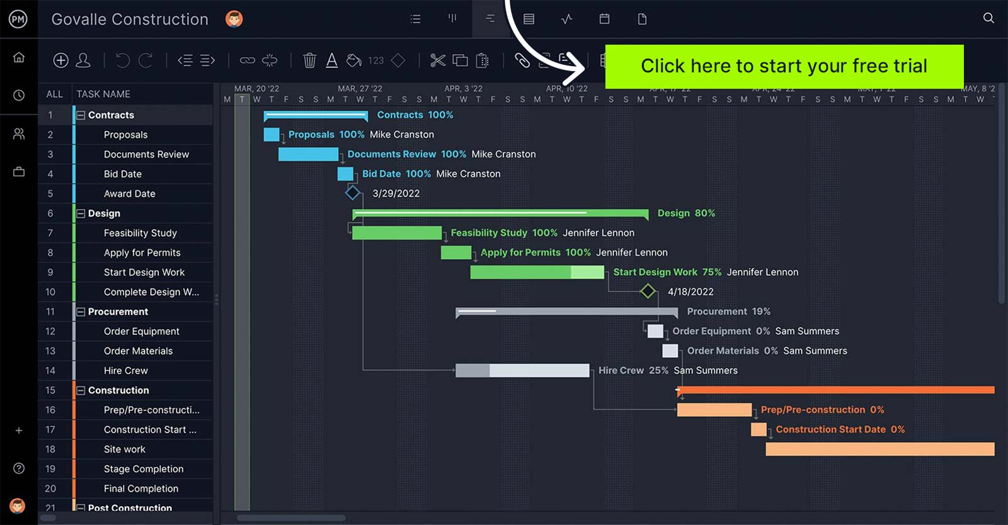
Gant Chart

Slide 10
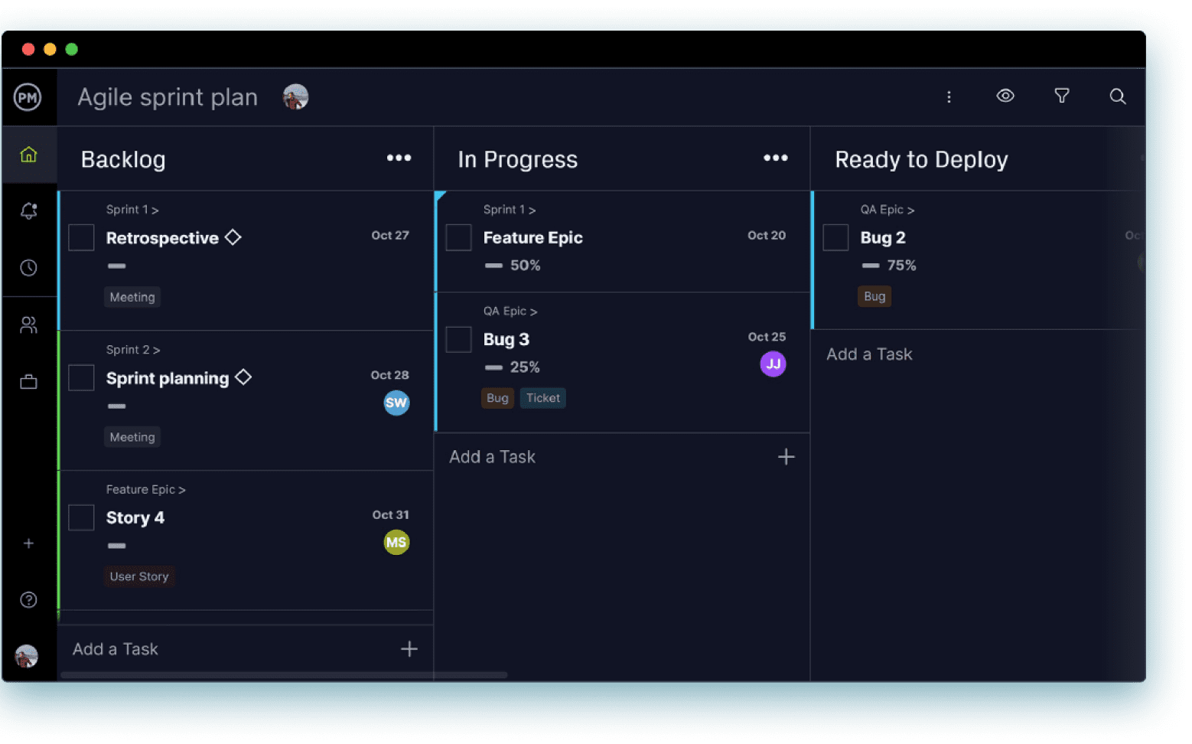
Kanban

Slide 11
Outline
Breaking Down Work Structure
Activity Sequencing and Scheduling
Estimating Activity Durations and Resources
Developing a Project Schedule with Timelines
Risk Identification and Assessment
Notes:
In software development, agile methodologies like Scrum and Kanban are prevalent. These methodologies require a well-structured plan for iterative development, where adaptability is key.,
Meeting or exceeding stakeholder expectations is essential. A well-planned project increases the chances of delivering a product that aligns with stakeholders' needs and goals., Planning generates documentation that can be useful throughout the project's lifecycle and beyond. It provides a reference for decision-making and can be a valuable resource for future projects., When issues arise during the project, a well-structured plan can serve as a basis for problem-solving. It helps in quickly assessing the impact of issues and determining appropriate solutions., By regularly reviewing and updating the project plan, you can implement lessons learned from previous projects, fostering a culture of continuous improvement.

Slide 12
Activity Sequencing and Scheduling
Activity Dependencies: Identify dependencies between activities. Some tasks can only start after others have been completed. Dependencies can be categorized as:
Finish-to-Start (FS): Activity B can only start after Activity A finishes.
Start-to-Start (SS): Activity B can start as soon as Activity A starts.
Finish-to-Finish (FF): Activity B can only finish after Activity A finishes.
Start-to-Finish (SF): Activity B can finish as soon as Activity A starts.

Slide 13
Activity Sequencing and Scheduling
Sequence Activities: Arrange the activities in a logical sequence based on their dependencies. Start with the initial activity and proceed through the project. This sequence should create a path from the project's start to its completion.
Create a Network Diagram: A network diagram, such as a Precedence Diagramming Method (PDM) or a Project Evaluation and Review Technique (PERT) chart, can help visualize the sequence of activities. In a PDM, activities are represented as nodes, and dependencies as arrows.
Critical Path Analysis: The critical path is the longest sequence of activities that determines the minimum time required to complete the project. Identifying the critical path is vital for project schedule management.

Slide 14
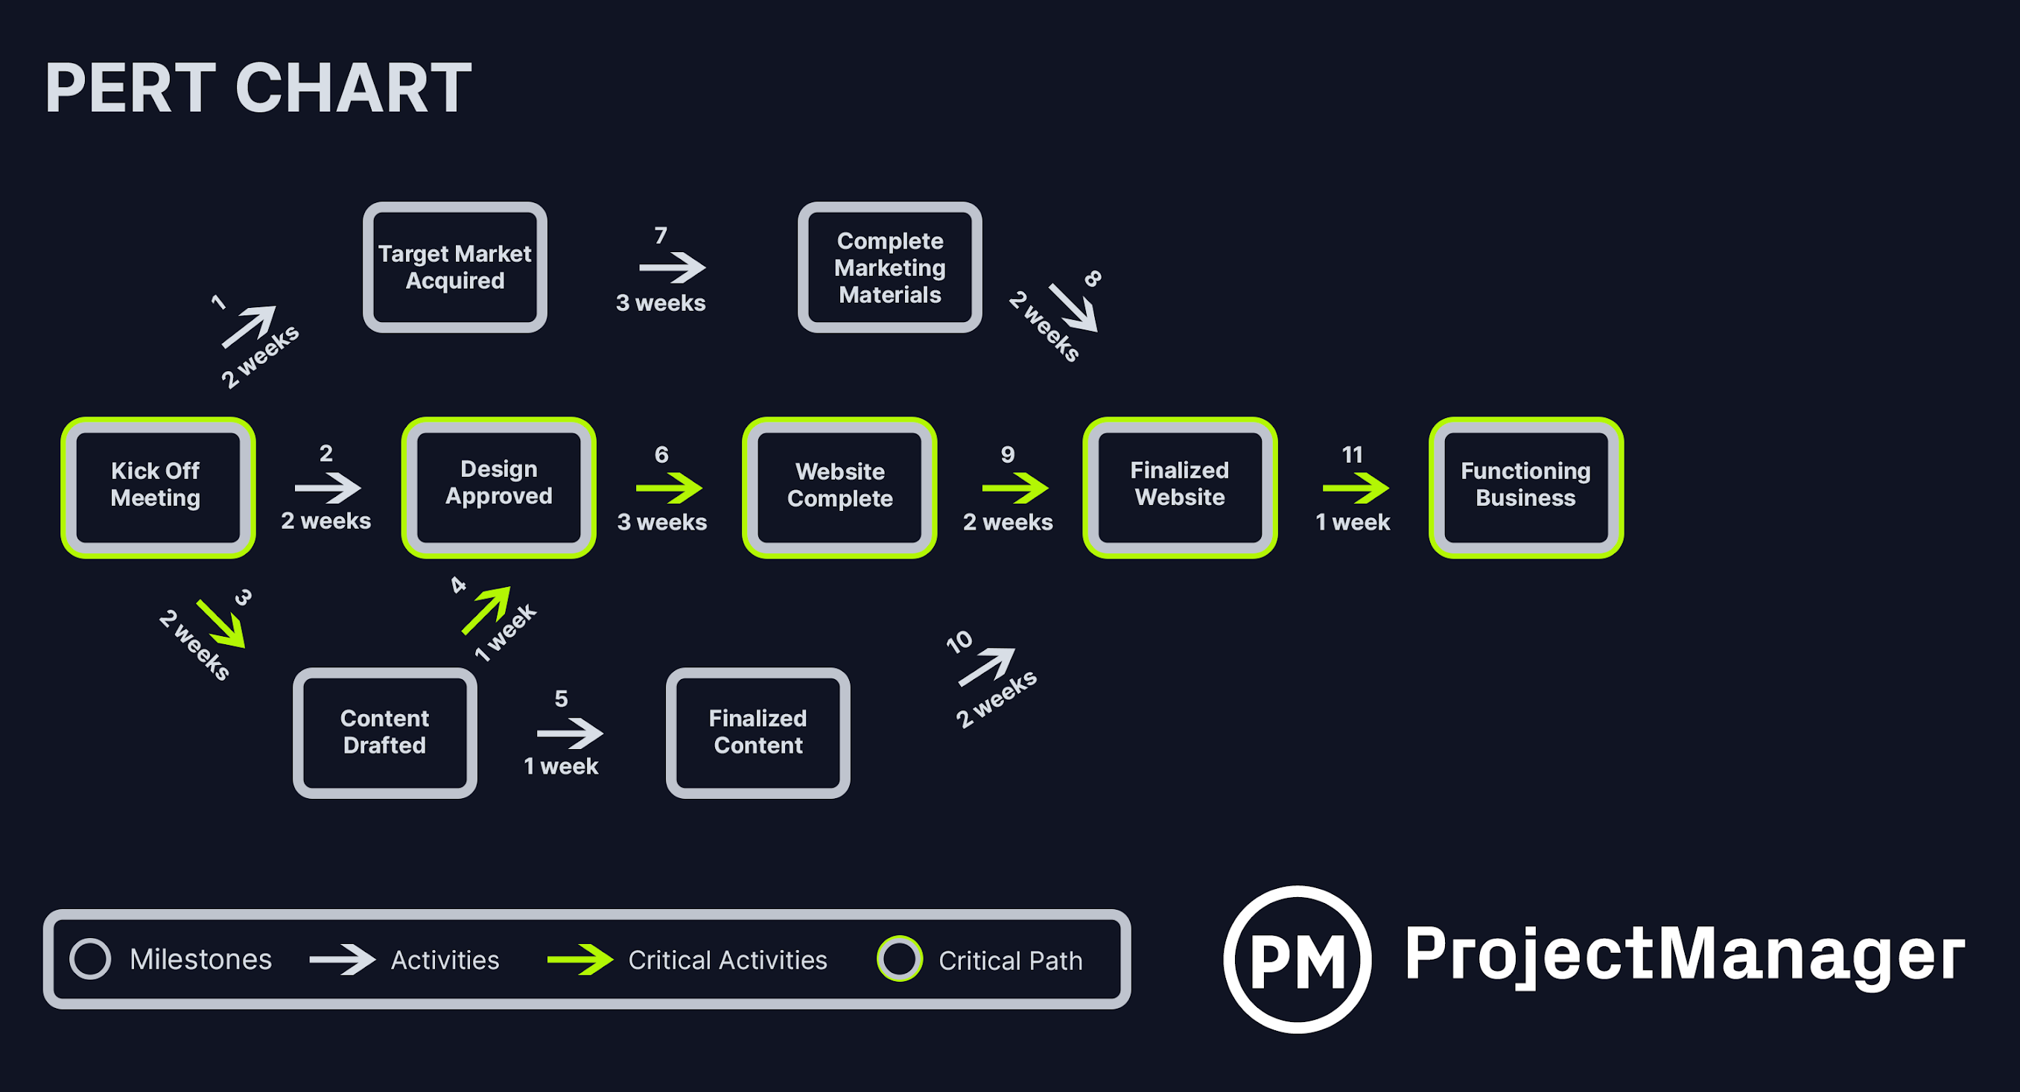
PERT Chart

Slide 15
Outline
Breaking Down Work Structure
Activity Sequencing and Scheduling
Estimating Activity Durations and Resources
Developing a Project Schedule with Timelines
Risk Identification and Assessment

Slide 16
Estimating Activity Durations and Resources
Estimation is a critical aspect of project management, as it helps determine the time, cost, and resources required to complete a project successfully. Various techniques are used to make accurate estimates.

Slide 17
Estimation techniques
Expert Judgment
This involves seeking input and insights from individuals who have significant experience or expertise in the relevant domain or field.
Expert judgment is especially useful in complex or specialized projects where historical data may not be available.
Historical Data
Historical data-based estimation relies on past project information and performance data to forecast future project outcomes.
It is effective when there's a repository of well-documented and relevant project data.

Slide 18
Estimation techniques
Analogous Estimation
Also known as top-down estimation, involves drawing parallels between the current project and similar past projects to make estimates.
Analogous estimation is helpful when historical data is limited, but there are similar projects to compare with.

Slide 19
Outline
Breaking Down Work Structure
Activity Sequencing and Scheduling
Estimating Activity Durations and Resources
Developing a Project Schedule with Timelines
Risk Identification and Assessment

Slide 20
Project Schedule
Creating a Project Schedule is an iterative process that requires ongoing attention and management.
A well-structured schedule helps ensure that activities are completed in a logical sequence and that the project is executed efficiently and on time.

Slide 21
Outline
Breaking Down Work Structure
Activity Sequencing and Scheduling
Estimating Activity Durations and Resources
Developing a Project Schedule with Timelines
Risk Identification and Assessment

Slide 22
Risk Identification and Assessment
Importance of Identifying and Assessing Risks:
Proactive Risk Management.
Risk Mitigation.
Cost and Schedule Control
Common Risk Assessment Techniques and Tools
Risk Matrices.
SWOT Analysis.
Delphi Method (Expert Opinions)
Brainstorming
Checklists
Risk Registers
Historical Data Analysis

Slide 23

Questions
????

